Slide 1
Off-Target Assessment (Risdiplam and Branaplam) –
Selection using Rasl-Seq Results
PCS - Adhithiya Charli
Computational Biology - Zhen Gao and Dann Huh

Slide 2
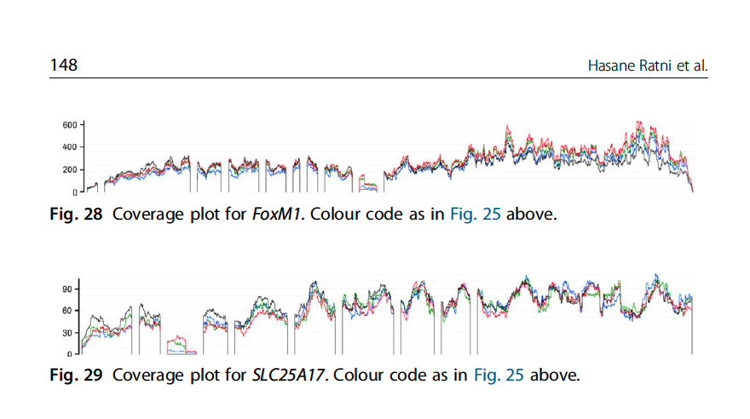
On-Targets and Off-Targets sequences
 | Doner Splice Site Consensus
 | AG|GURAGU
Gene Names | Risdiplam Consensus Binding sequence
SMN2 | GA|GTAAGT
APLP2 | GA|GTAAGT
FOXM1-inside | GA|GTAAGT
FOXM1-border | CA|GTAAGT
SLC25A17-inside | GA|GTAAGA
SLC25A17-border | AG|GTTAAA
(ref: Ratni Roche review, Progress Medicinal Chem V58, 2019)

Slide 3
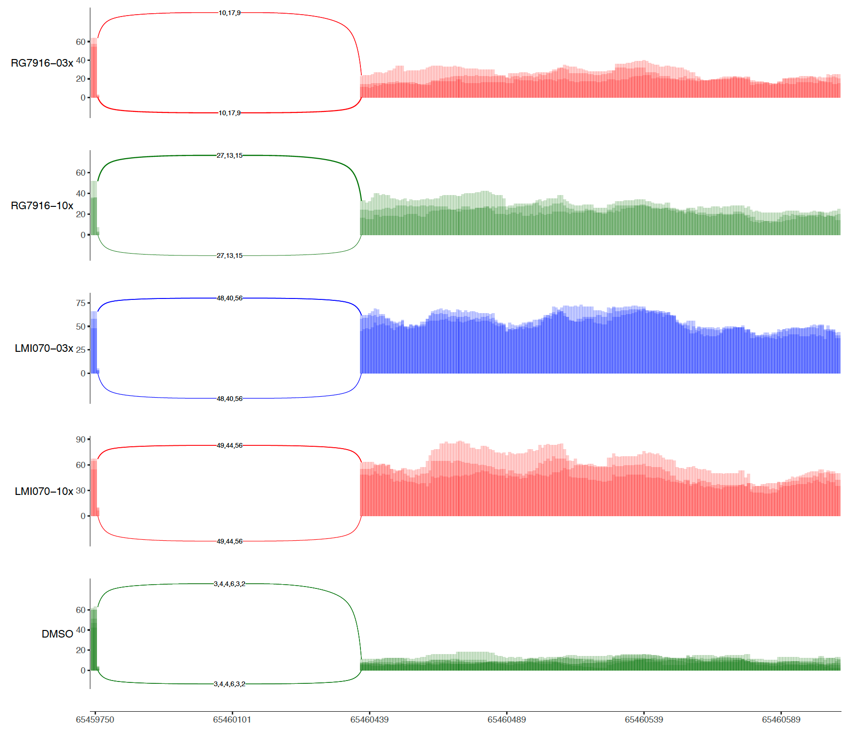
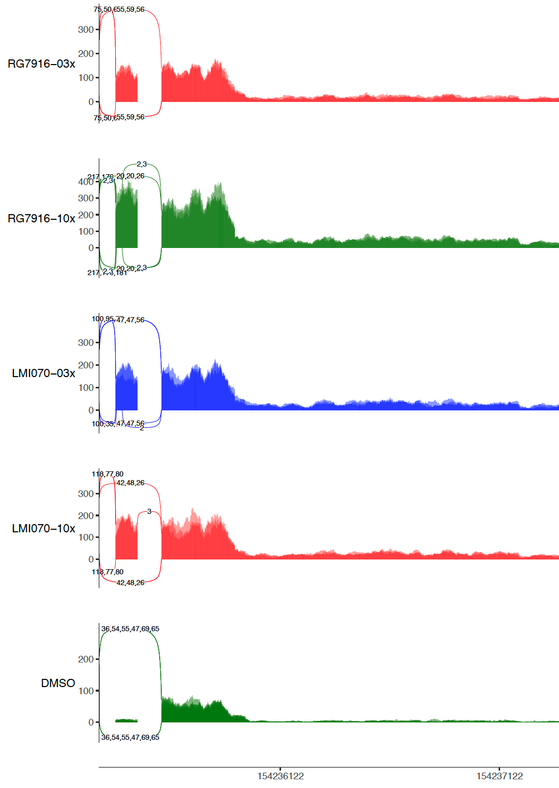
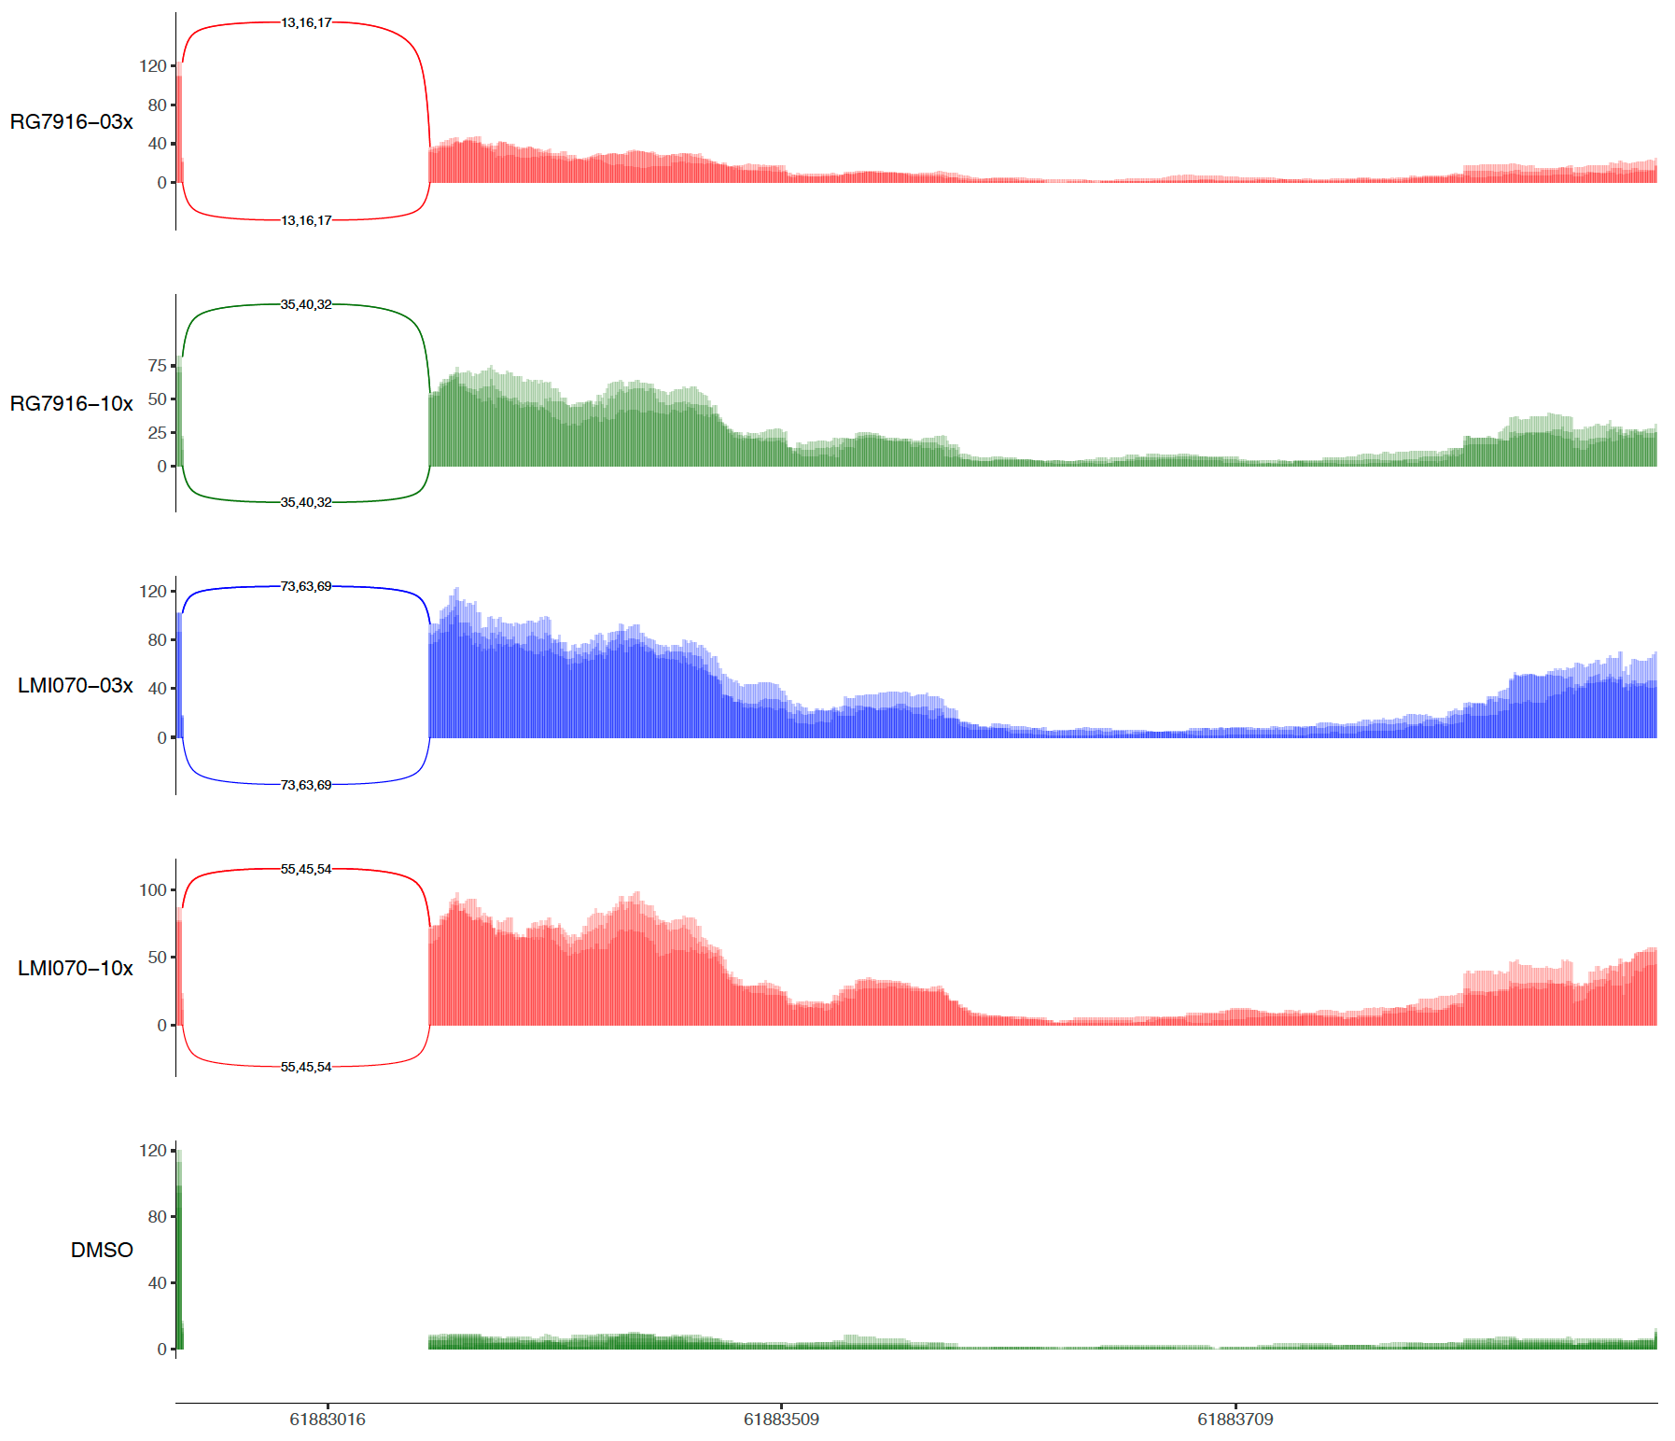
Example Sashimi-plots
SREK1
UBAP2L
DDX42
Green – No safety issues based currently available info and data from studies and clinical trials.
Yellow – Unknown or unclear safety issues (hard to predict with current info in hand) ; modest genetic evidence

Slide 4
Genes with largest |dPSI|
Row.names | dPSI_RG7916_10x | dPSI_RG7916_03x | dPSI_LMI070_10x | dPSI_LMI070_03x
PDXDC2P | 0.973107072 | 0.826747387 | 0.97245737 | 0.972808118
RP11-419C5.1 | 0.973147084 | 0.823670887 | 0.972441415 | 0.972765321
POMT2 | 0.962 | 0.460619955 | 0.971 | 0.956
STRN3 | 0.842 | 0.499 | 0.87 | 0.844
LARP7 | 0.862 | 0.455 | 0.954 | 0.934
MFN2 | 0.799 | 0.305 | 0.389 | 0.395
UBAP2L | 0.786145234 | 0.316381631 | 0.467136866 | 0.443633539
RAPGEF1 | 0.71 | 0.352 | 0.387 | 0.349
SMN2 | 0.523 | 0.523 | 0.517 | 0.513
SNAP23 | 0.794 | 0.213 | 0.355 | 0.379
ASCC3 | 0.695500402 | 0.182709524 | 0.479443487 | 0.165006258
VPS29 | 0.55 | 0.318 | 0.838 | 0.791
COPS7B | 0.615 | 0.252 | 0.495 | 0.438
TRIM65 | 0.525 | 0.313 | 0.525 | 0.525
DDX42 | 0.612397195 | 0.188200088 | 0.784825057 | 0.827833031
FOXM1 | 0.464455496 | 0.274398508 | 0.309370517 | 0.313948008
RAP1A | 0.44 | 0.293 | 0.292 | 0.368
SENP6 | 0.363 | 0.275 | 0.555 | 0.547
SPATA18 | 0.464 | 0.159 | 0.165 | 0.16
CECR7 | 0.331307764 | 0.281873587 | 0 | 0.319379644
DENND5A | 0.494 | 0.106 | 0.206 | 0.188
APLP2 | 0.396 | 0.199 | 0.341 | 0.339
C19orf24 | 0.308369038 | 0.26195883 | 0.234696657 | 0
FAM162A | 0.466 | 0.102311958 | 0.13 | 0.135
VAV2 | 0.384897629 | 0.172990113 | 0.138263938 | 0
SREK1 | 0.388 | 0.159 | 0.844 | 0.79
FBN2 | 0.365461786 | 0.135659125 | 0.184294391 | 0.190675511
UBE2V1 | 0.258 | 0.219 | 0.232 | 0.235
DGKA | 0.348 | 0.123 | 0.41 | 0.434
TNS3 | 0.353431964 | 0.116996996 | 0.228711976 | 0
EVC | 0.317318119 | 0.149942933 | 0.474409976 | 0.511829497
PPHLN1 | 0.269 | 0.18 | 0.224 | 0.226
GGCT | 0.225 | 0.216 | 0.225 | 0.225
EXTL2 | 0.24133903 | 0.194194488 | 0 | 0
ADAMTS14 | 0.216 | 0.216 | 0 | 0
GAPVD1 | 0.278827932 | 0.147568693 | 0.183296818 | 0.165774983
FAM174A | 0.245889595 | 0.176829311 | 0.206754536 | 0.166728819
FBXO31 | 0.184129934 | 0.23493396 | 0.20333213 | 0.325846065
TARBP1 | 0.209 | 0.189 | 0.197694987 | 0.129149385
NGF | 0.173924978 | 0.215680513 | 0.148841958 | 0.149614623
C11orf73 | 0.275 | 0.104 | 0.188 | 0.201
APIP | 0.187727078 | 0.178975927 | 0.146039588 | 0.169213776
PAPD4 | 0.239905666 | 0.103521781 | 0.30803524 | 0.408188937
PAN2 | 0.162 | 0.161 | 0.176 | 0.16
MYPN | 0 | 0.322 | 0.235 | 0
ZNF326 | 0.132 | 0.187 | 0 | 0.198
GRAMD3 | 0.198 | 0.115793891 | 0.146976474 | 0.13908277
WIZ | 0 | 0.295 | 0.295 | 0
FAHD2A | 0.15 | 0.144 | 0 | 0.165
FAM198B | 0.118 | 0.164979151 | 0.523680074 | 0.50929153

